Slide 1

Data Profiling Application
Team : TRAFFICCITYWARRIORS
Anoop Velappan
Anoop Thakur
Abhishek Gupta

Slide 2
Technology STACK
Python
Streamlit is for visualization and creating interactive webpages
Bard API is a powerful tool that allows developers to access the capabilities of Google’s large language model. Bard to generate text, translate languages, write different kinds of creative content, and answer questions in an informative way.
Pandas is a powerful and popular Python library used for data manipulation and analysis
PyCharm is a popular integrated development environment (IDE) developed by JetBrains, specifically designed for Python development

Slide 3
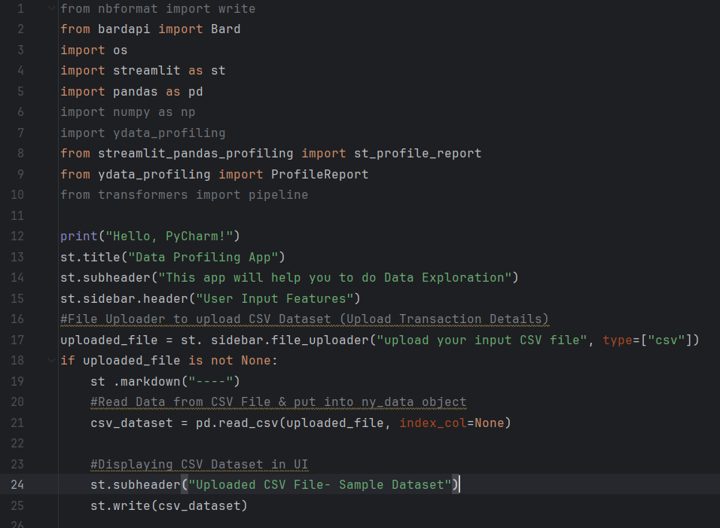
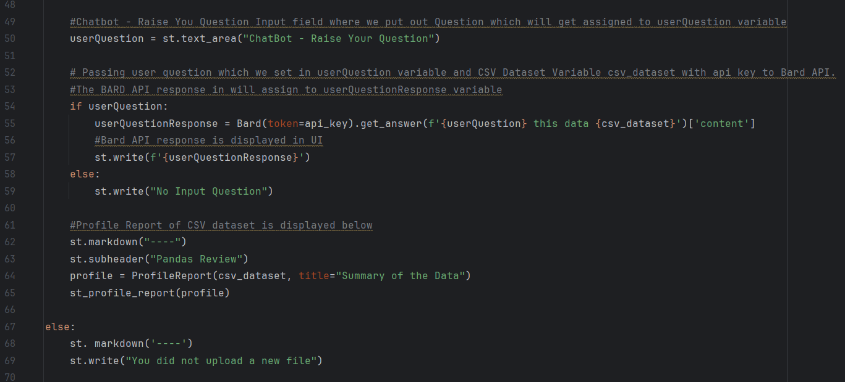
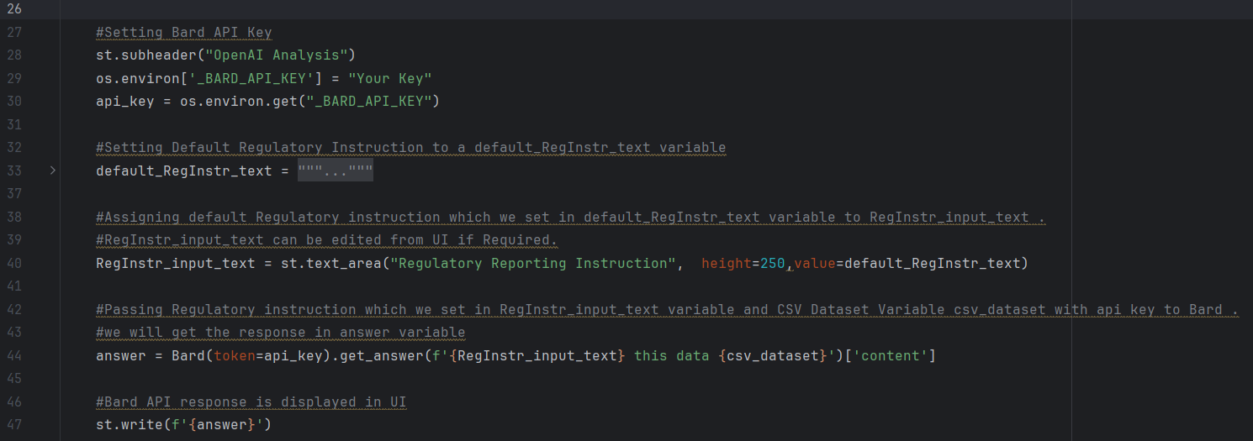
Code

Slide 4
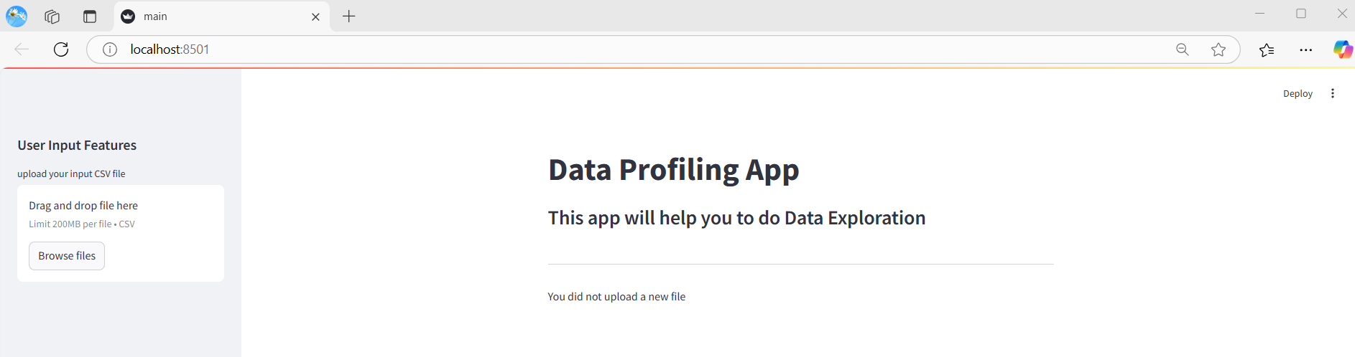
Initial PAGE

Slide 5
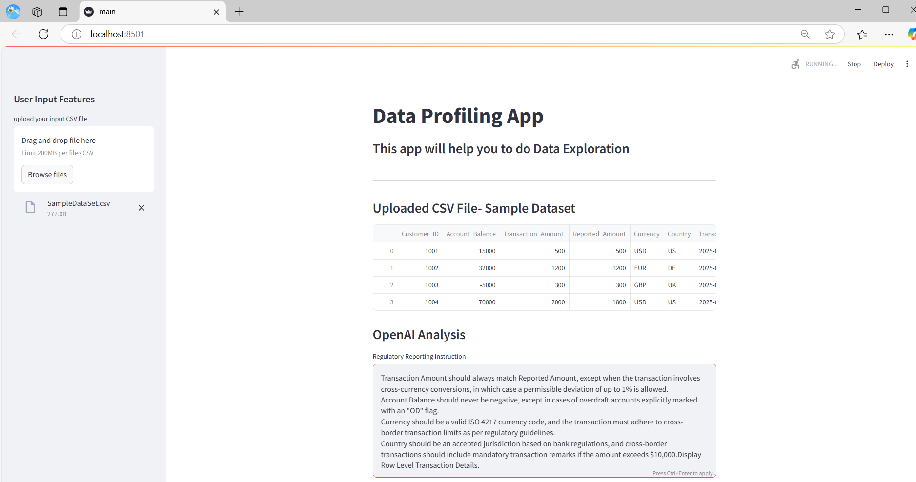
UPLOADED CSV FILE – Default REGULATORY INSTRUCTION

Slide 6
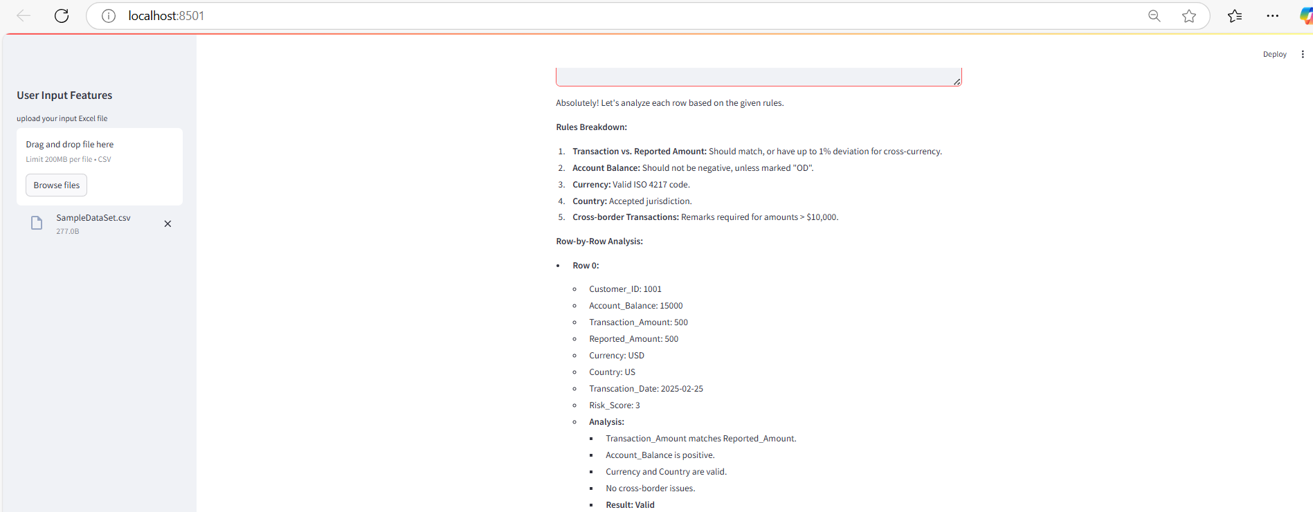
Bard API – Response (Customer 1001)

Slide 7
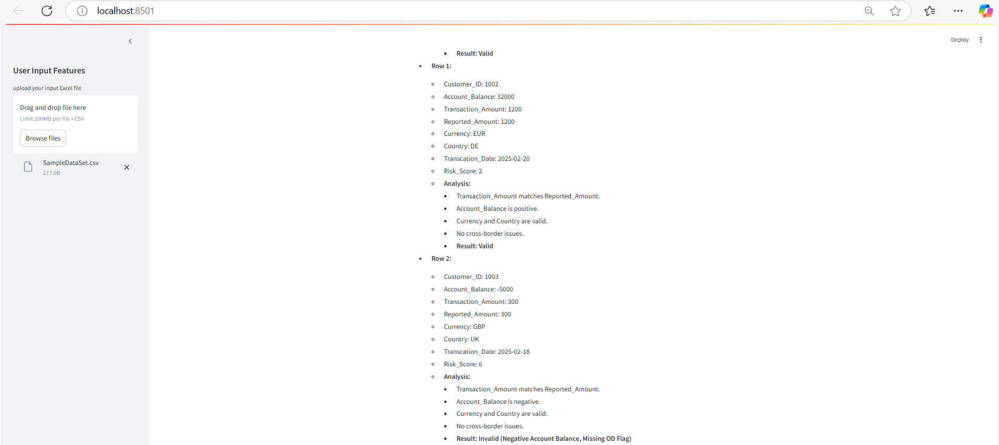
Bard API – Response (Customer 1002 & 1003)

Slide 8
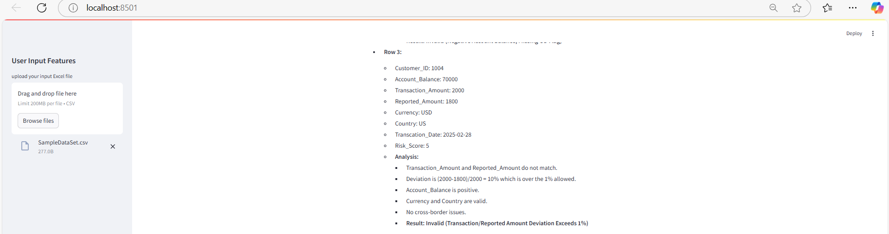
Bard API – Response (Customer 1004)

Slide 9
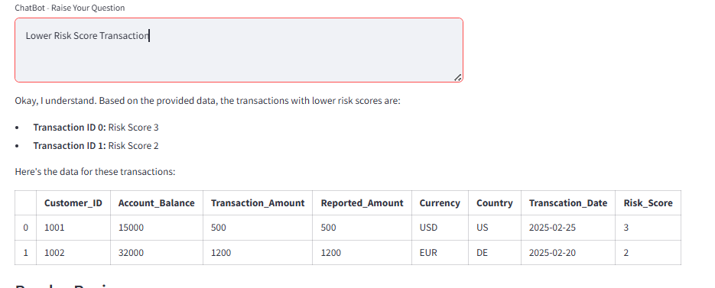
Raise Your QUESTION

Slide 10
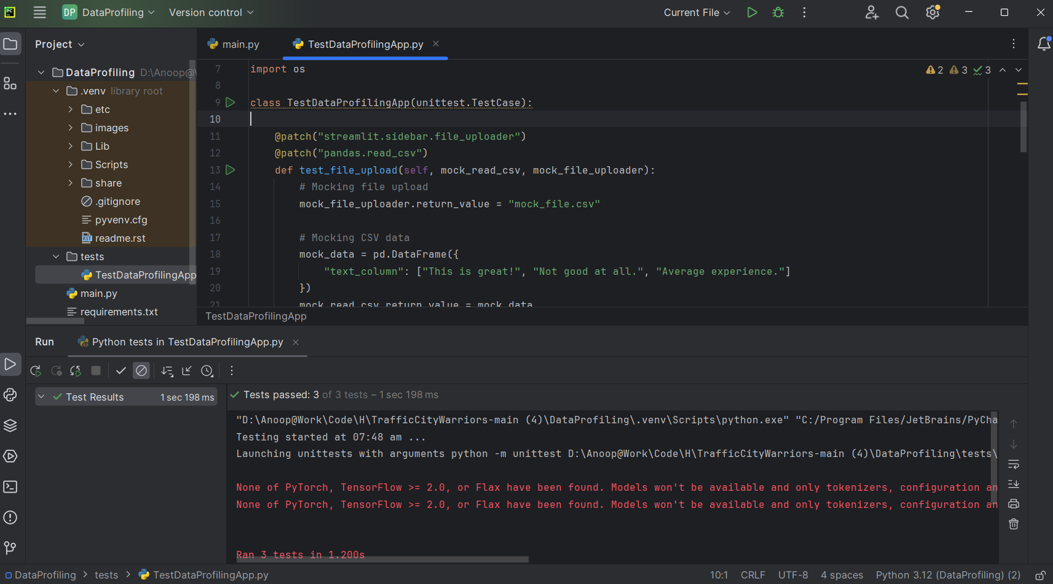
Test Results

Slide 11
Thank You…!

